Slide 1



Oil Well Predictions Using Deep Learning
AKASH LEVY, ALBERT TUNG, JANETTE GARCIA, MICHELLE (RUOMENG) YANG

Slide 2
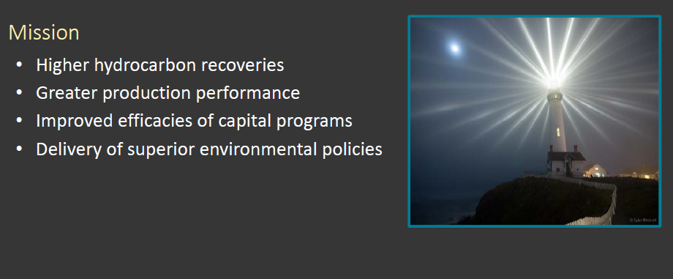
Quantum Reservoir Impact (QRI)
Project proposed by QRI’s innovation team
Big question: Does deep learning apply to the petroleum industry?
Develop a proof of concept
Notes:
<number>

Slide 3
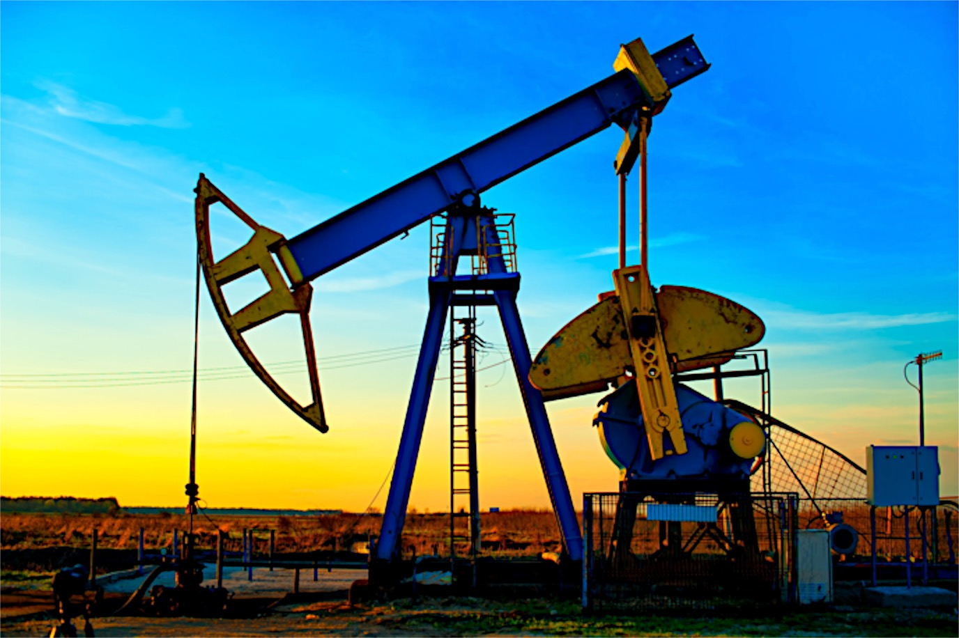
Problem Statement
Goal:
Forecast oil production rate in petroleum wells
Given:
Data from oil wells worldwide
Strategy: Machine learning
Use machine learning to detect “events”
Repairs, upgrades, other modifications to wells
Given a well, forecast oil production for the next year
Notes:
• Data was anonymized
• Included 7 different sites
• Each site has hundreds of wells
• Each well has data recorded each month
• Data includes name of well, oil output, water output, and gas output
• Data is noisy and many measurements were not taken
• Each well has a different length history
Suggestion: don’t mention deep learning until later. Stick to works in slide
<number>

Slide 4

Current QRI Approach
Based on heuristics and statistics
Works well and delivers intended results
Limitations:
Slow
Limited to time series
Vision: Deep learning solves many problems in the future
Fast interpretations
Different types of events identified
More complex information can be added
Predicting Oil Well Data
Oil Production
Year
Notes:
• To do prediction they just extrapolate these curves
• Linear regressions for events; exponential decay otherwise
• That might not be right
<number>

Slide 5
QRI Prediction using Hard-coded Regression Model
Predicting Oil Well Data
Problems:
Manually developed
Human bias/error
Not easily adaptable
Less scalable for larger datasets
Oil Production
Year
Notes:
• Black diamonds are events
• This process is not idea, so use deep learning
<number>

Slide 6
Deep Learning
An introduction

Slide 7
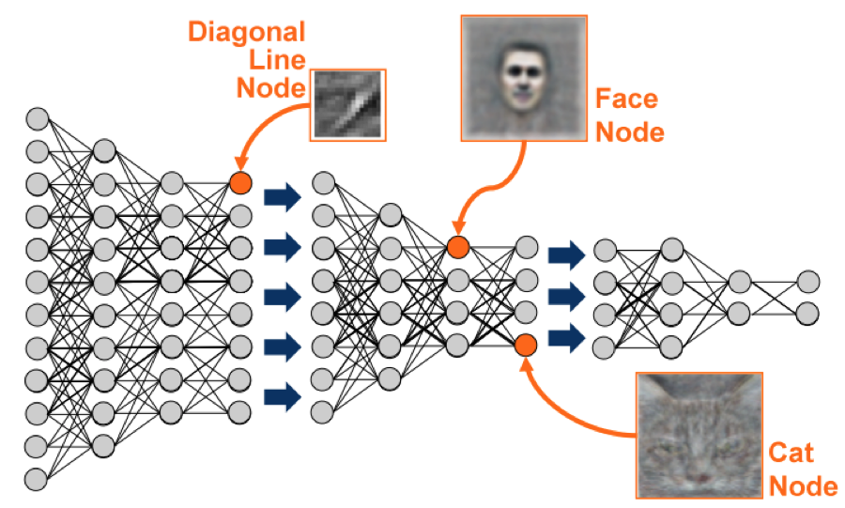
What is Deep Learning?
Sophisticated form of machine learning
Applications:
Speech recognition
Natural language processing
Face recognition
Stock market forecasting
(Google’s deep learning algorithm recognizes faces when applied to YouTube videos)
Notes:
• More sophisticated than machine learning because multiple hidden layers
- Math within the hidden layers also more complex (possibly)
- Allow networks to learn more or higher level features
• Stock market forecasting is similar to our work
<number>

Slide 8
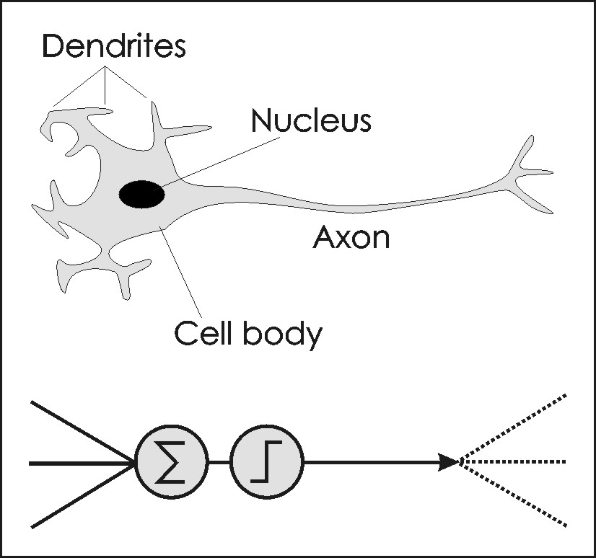
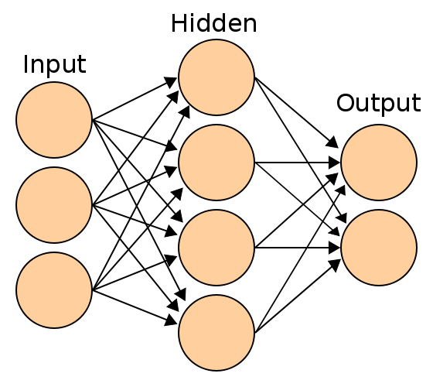
How Does Deep Learning Work?
Deep learning uses neural networks
Attempt to mathematically model human brain
(a) Dendrite versus neural network
(b) Simplest neural network layout
Notes:
• Neural network:
- Mathematical model that attempts to mimic the brain’s representation of information
• This represents the simplest form
• Deep learning usually consists of multiple hidden layers and other steps between layers
• It may also involve putting constraints on the system
• We will discuss other forms later on in this presentation
<number>

Slide 9
Different Deep Learning Models
Hidden
Hidden
Input
Output
Complicated neural networks contain multiple hidden layers
Notes:
• Visual models of different types of deep learning models
- Multiple hidden layers
• Explain that the math within the hidden layers separates different deep learning models
<number>

Slide 10
Restricted Boltzmann Machine (RBM)
Fully-Connected Network
Convolutional Neural Network (CNN)
Recurrent Neural Network (RNN)
Deep Learning Models Implemented

Slide 11
Data Preprocessing
From start to finish

Slide 12
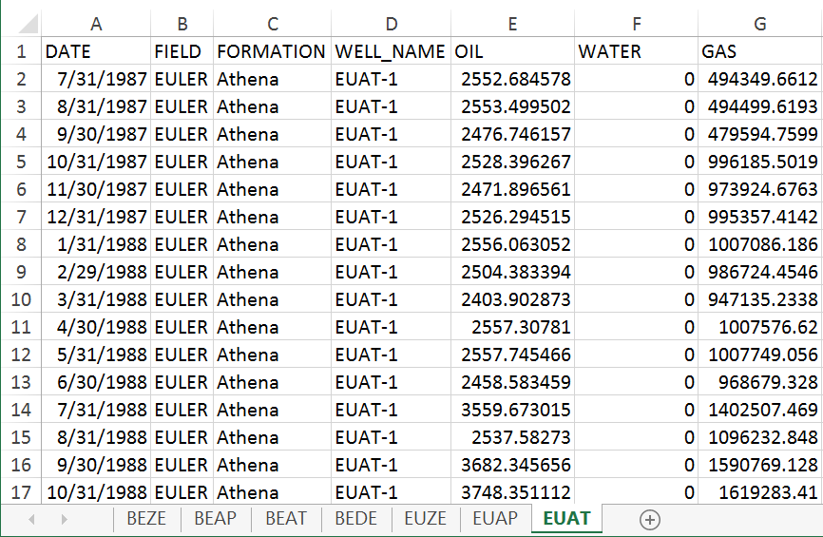
Raw Data Format
Notes:
• View of the raw excel file given to us
• Date: date measurement was taken; taken on the last day of the month
• Field: name (anonymized) given to the site where the oil wells are located
• Formation: type of oil well
• Well name: first two letters of field name, first to letter of formation, and index
• Oil: barrels of oil produced in one month (this is what we care about)
• Water: barrels of water produced in one month
• Gas: amount of gas produced in one month (this is not as important as it sounds; we just care about oil)
<number>

Slide 13
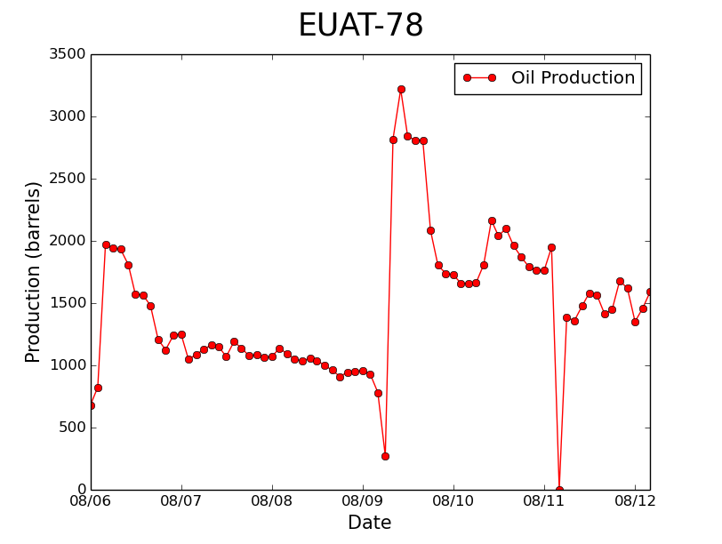
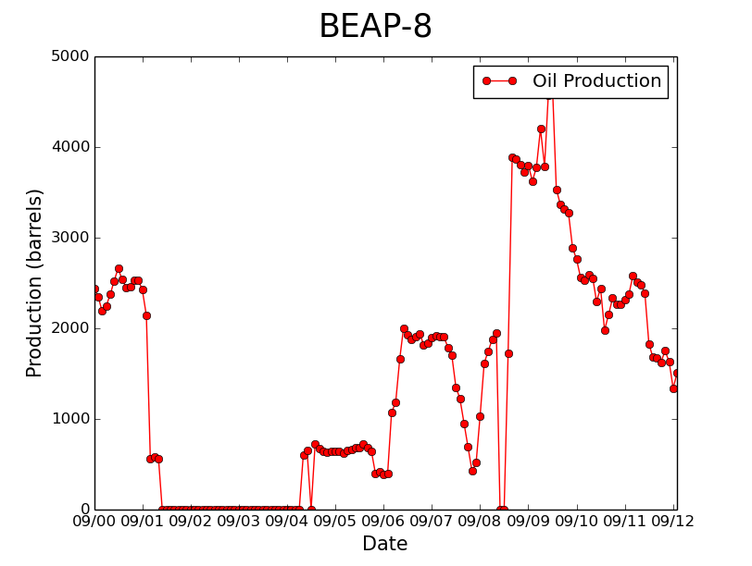
Oil Well Production Data
Notes:
• Visualization of data we were given
• EUAT-78 is the typical well
• BEAP-8 has lots of zeros
<number>

Slide 14
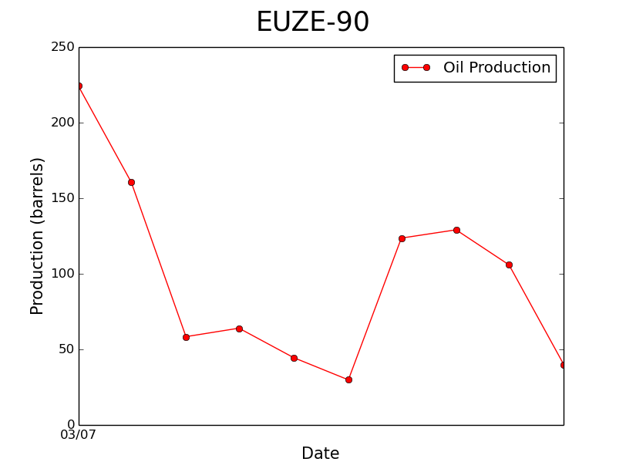
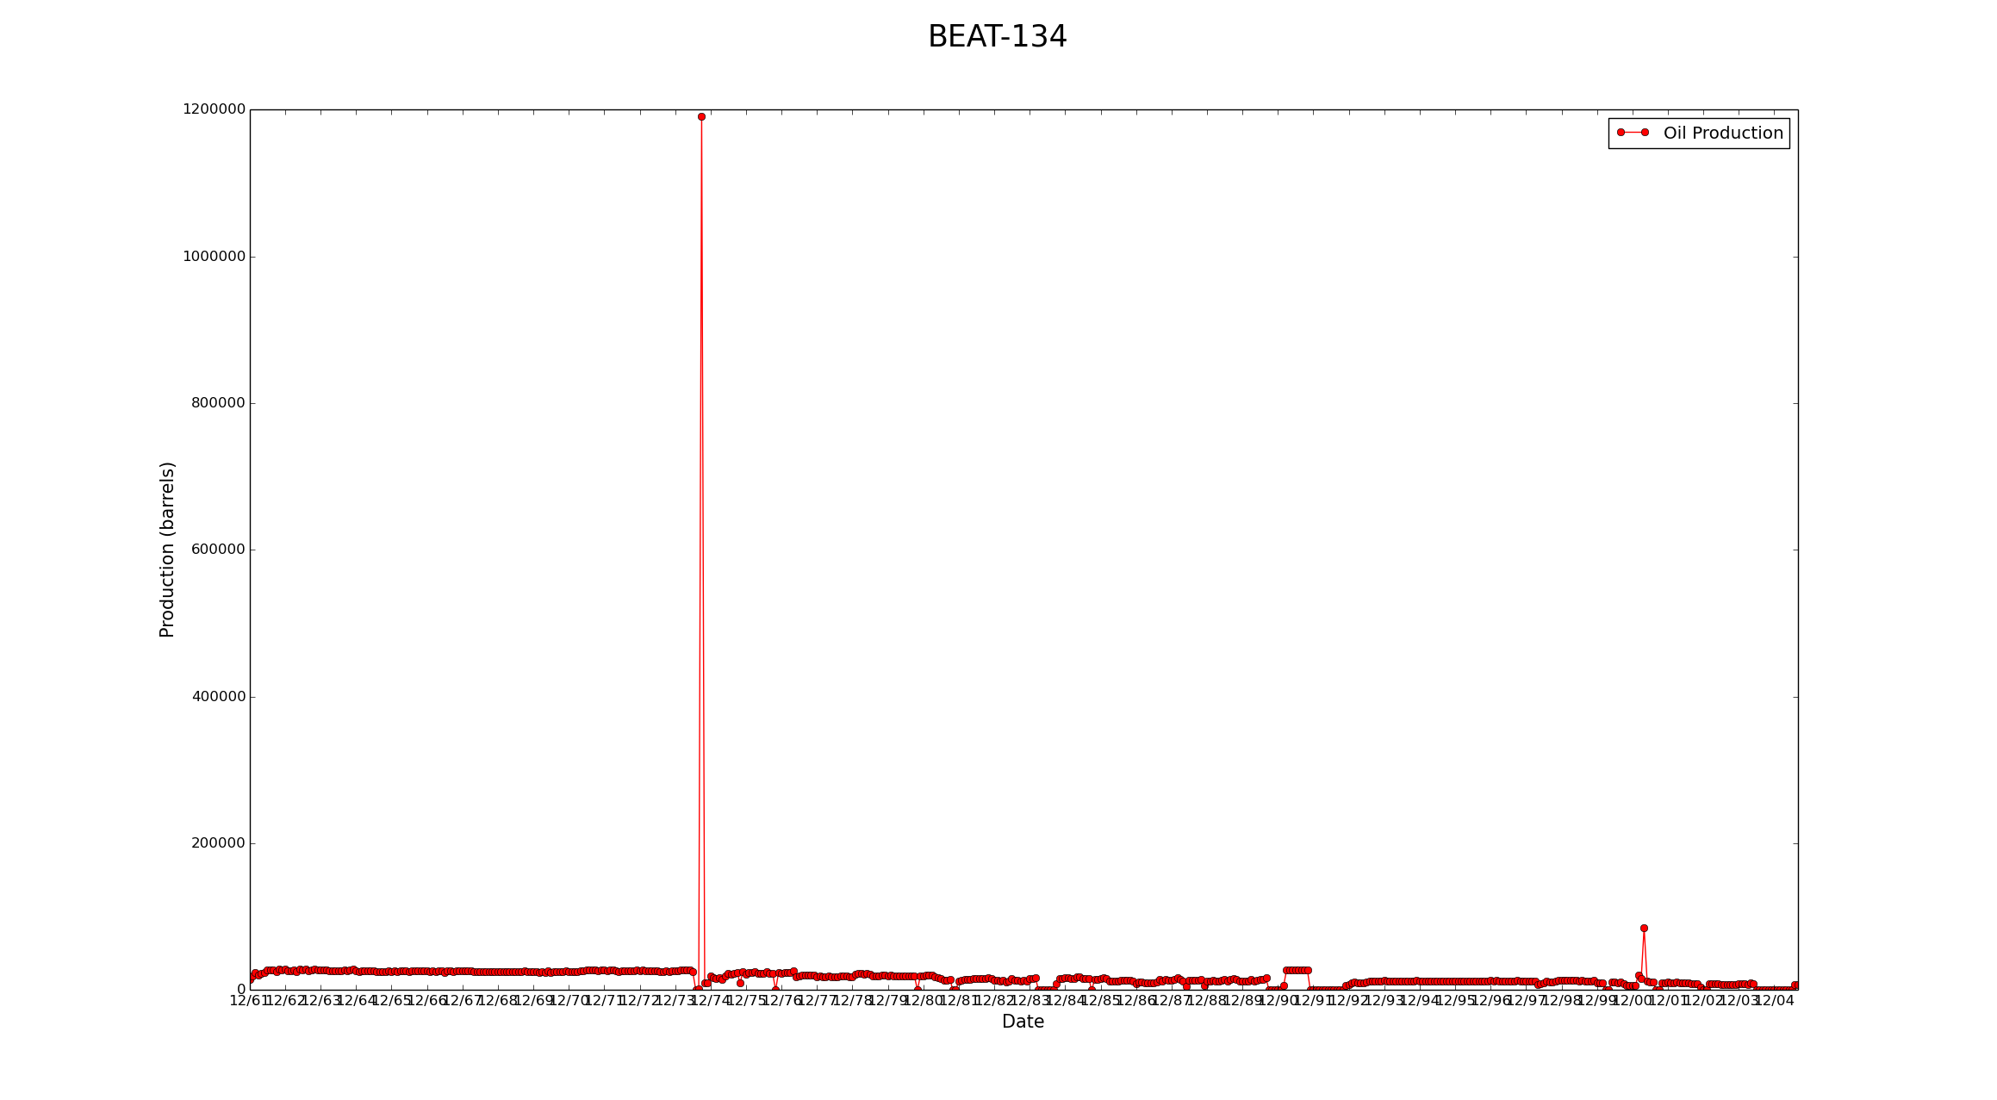
Oil Well Production Data
Notes:
• EUZE-90 not enough points to make predictions
• BEAT-134 has a huge outlier
<number>

Slide 15
Preprocessing
Site 1
Site 3
Well 1
Well 2
Well 3
Well 1
Well 2
1. Each site has multiple wells. Each well has different amounts of data
2. Remove zeros from data
3. Turn wells into chunks
4. Normalize chunks
5. Split into training, validation, and testing sets
…
…
Site 2
…
Well 1
Well 2
Well 1
Well 2
Well 3
…
…
Notes:
• Our data set from a top view
<number>

Slide 16
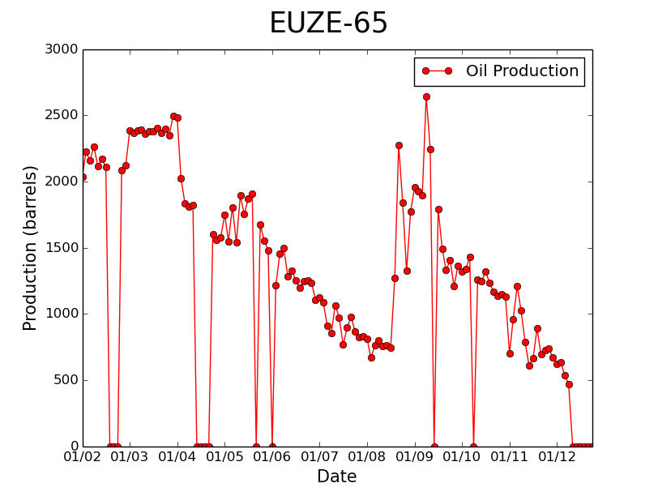
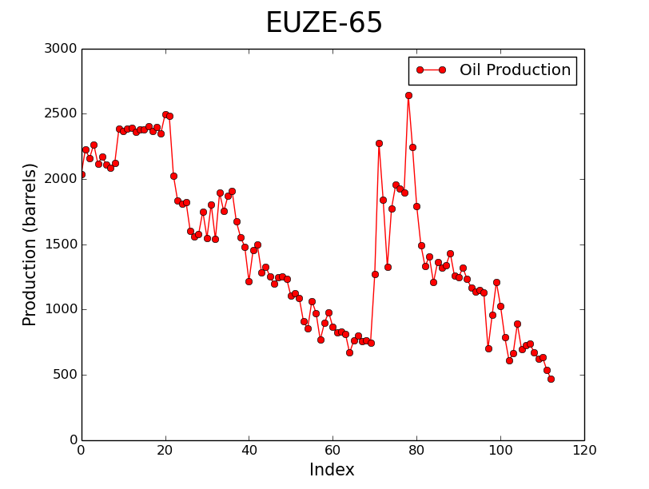
Preprocessing
Well 1
1. Each site has multiple wells. Each well has different amounts of data
2. Remove zeros from data
3. Turn wells into chunks
4. Normalize chunks
5. Split into training, validation, and testing sets
Notes:
• These points are almost always a result of something gone wrong:
Oil well was turned off for repair
Oil well was turned off for lack of profit
Measurement was not taken
• These are points we do not want to include in any of our datasets
<number>

Slide 17
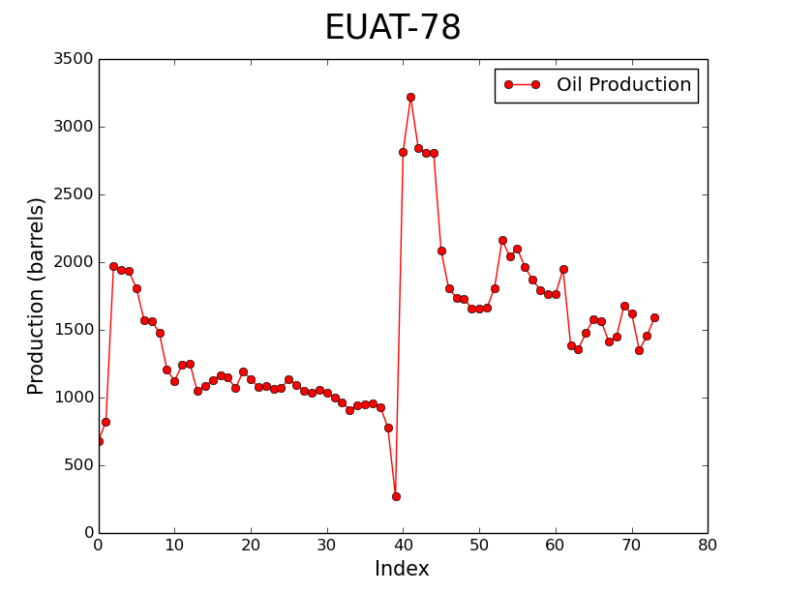
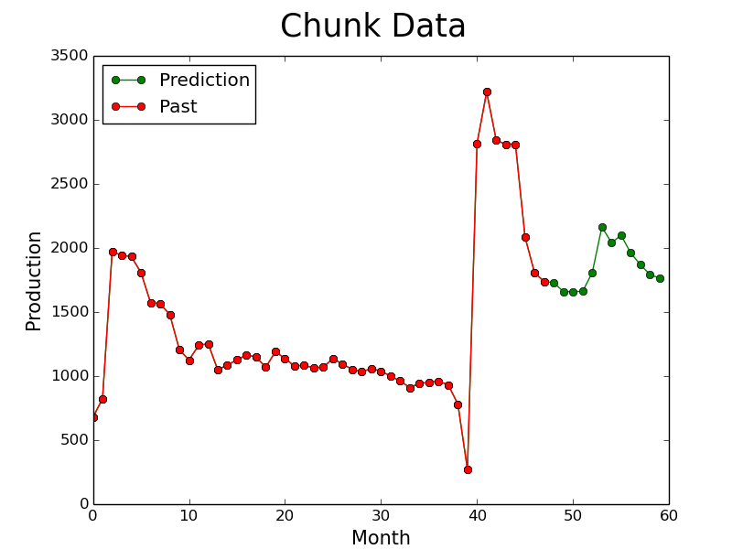
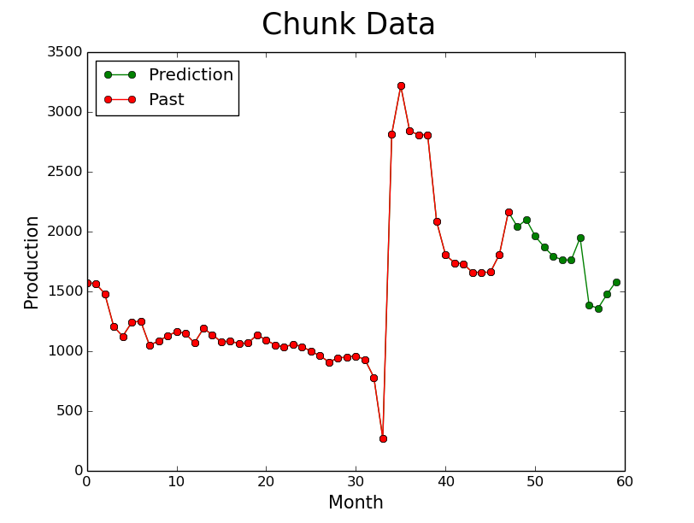
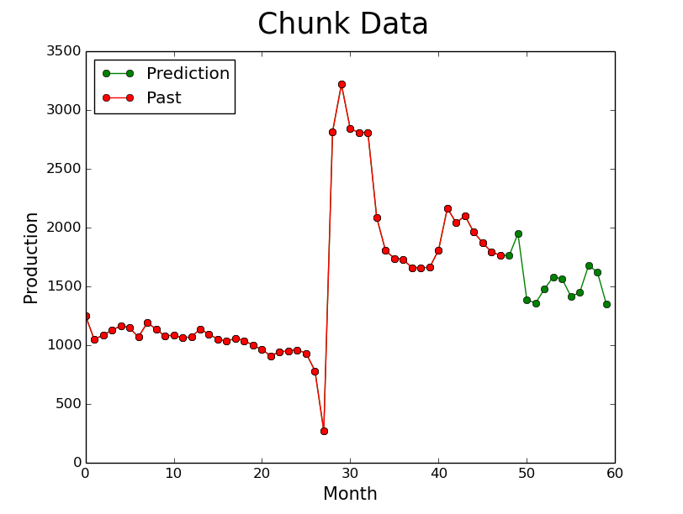
Preprocessing
Well 1
1. Each site has multiple wells. Each well has different amounts of data
2. Remove zeros from data
3. Turn wells into chunks
4. Normalize chunks
5. Split into training, validation, and testing sets
Chunk 1
Chunk 2
Chunk 3
Notes:
• Take sliding window approach
• Some machine learning algorithms only take fixed size input
• Another advantage: ensures that enough data is being trained on
• We used:
- Input size: 48 months (4 yrs.)
- Output size: 12 months (1 yrs.)
- Step size: 6 months
• Instruct machine: “given this input, you should produce this output”
<number>

Slide 18
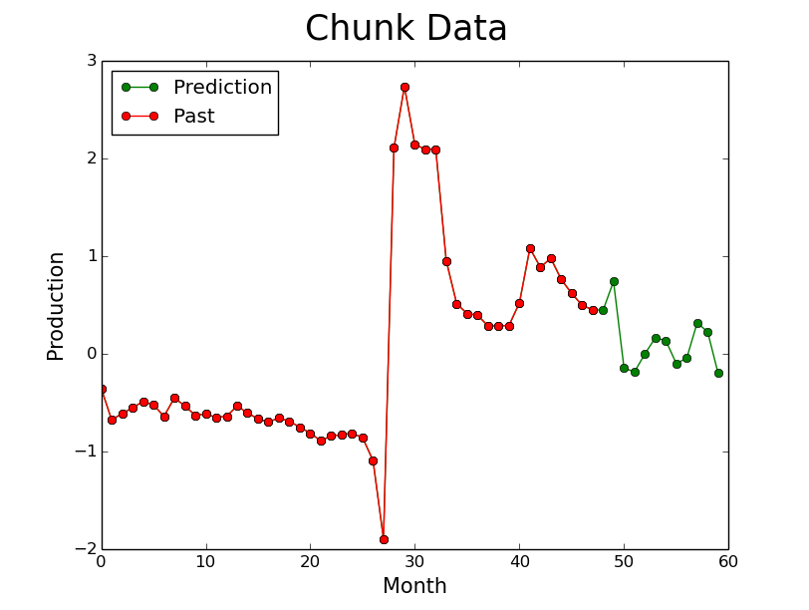
Preprocessing
Chunk 1
1. Each site has multiple wells. Each well has different amounts of data
2. Remove zeros from data
3. Turn wells into chunks
4. Normalize chunks
5. Split into training, validation, and testing sets
Notes:
• Normalize:
- Subtract mean, divide by standard deviation
• Ensures that chunks are centered at 0 and equally distributed
• Check that you normalize with respect to the input only!
• We forgot to do that and got overly-optimistic results
<number>

Slide 19
Preprocessing
Well 1
Training set
Chunk 1
Chunk 2
Chunk 3
Chunks from well 1
…
…
1. Each site has multiple wells. Each well has different amounts of data
2. Remove zeros from data
3. Turn wells into chunks
4. Normalize chunks
5. Split into training, validation, and testing sets
Well 2
Validation set
Chunk 1
Chunk 2
Chunk 3
Chunks from well 2
…
…
Well 3
Testing set
Chunk 1
Chunk 2
Chunk 3
Chunks from well 3
…
…
Notes:
• Training dataset
- Examples shown to the network
• Validation dataset
- Different set of examples to determine when to stop training
• Testing dataset
- Examples to evaluate the performance of the network
• Used a 6:1:1 ratio to split the wells
• Did splitting randomly from sites
<number>

Slide 20
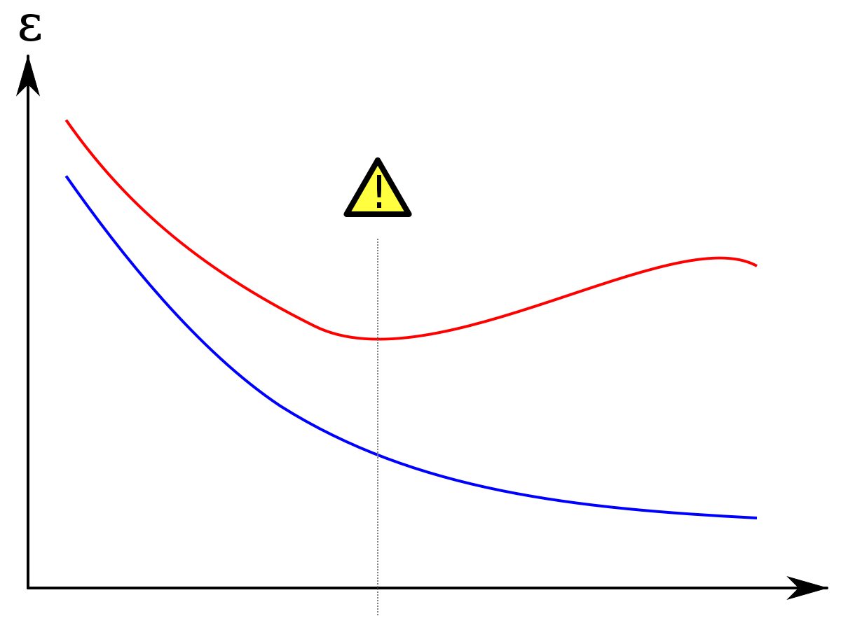
Why Three Datasets are Needed
Error
Validation Set
Overtraining: predictions continue to get better on data network has seen but not on new data
Training Set
Testing set: independent set that offers an evaluation of your network
Training Steps
Notes:
• Prediction works less well on new data
• Validation set HAS influenced training because it determined when to stop
• Stop training at exclamation mark
• Evaluate network on testing set, which hasn’t influenced training at all
<number>

Slide 21
Deep Learning Models
Their architectures, effectiveness, and efficiency

Slide 22
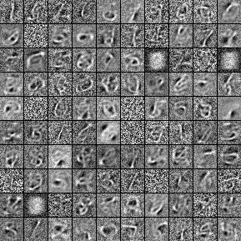
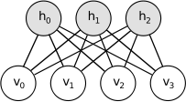
Restricted Boltzmann Machines (RBM)
Name: Restricted Boltzmann Machines
Description:
Best at dimensionality reduction, feature learning, and topic modeling
Learns a probability distribution over its inputs
Generative model
Notes:
• Energy-based; will try to reduce energy (most likely)
• Uses hidden units
• Uses Gibbs sampling when training to update weights
• Uses contrastive divergence for sampling
- (Gibbs sampling, prop-up, prop-down)
• Visible, w, hbias
• H, wT, vibias
<number>

Slide 23
Fully-Connected Network
Name: Fully-Connected Network
Description:
Performs matrix multiplication with the input and adds a bias to produce the output
Feed-forward network
Every node is connected
Hidden
Input
Output
Notes:
• Accuracy based on test set loss
<number>

Slide 24
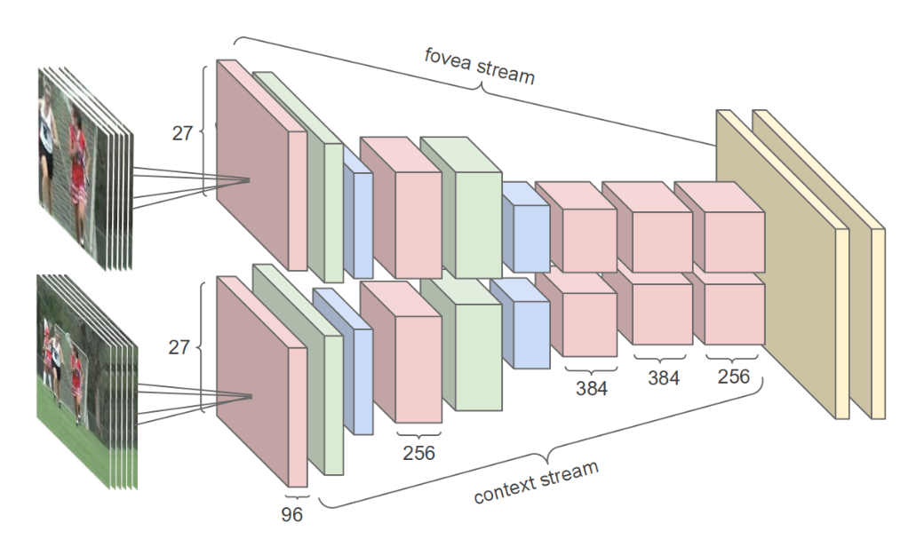
Convolutional Neural Network (CNN)
Name: Convolutional Neural Network
Description:
Best at image recognition
Evaluates convolution of input with multiple filters
Connects result to hidden layer
Shared weights between inputs
Input
Hidden
Output
Notes:
• Mention shared weights
• What are filters?
• Run with 13 kernels, 100 filters.
• Performs significantly faster on GPU than CPU.
<number>

Slide 25
Recurrent Neural Network (RNN)
Implemented Architectures
Model Name | Description | Accuracy | Training time
Simple RNN | Layer’s output is fed as input | 5/5 | 1/5
Simple Deep RNN | Simple RNN with several layers | 4/5 | 2/5
GRU | Simple RNN + reset and update gates | 1/5 | 3/5
LSTM | Simple RNN + input, forget, output gates | 3/5 | 5/5
MUT-123 | Optimized GRU & LSTM | 2/5 | 4/5
Notes:
<number>

Slide 26
Recurrent Neural Network (RNN)
Name: Simple RNN
Description:
Best at sequence processing
Fully connected network where layers’ outputs are fed back in as inputs
Feed-back neural network
Uses internal memory to process sequences of input
Recurrent
Input
Output
Notes:
<number>

Slide 27
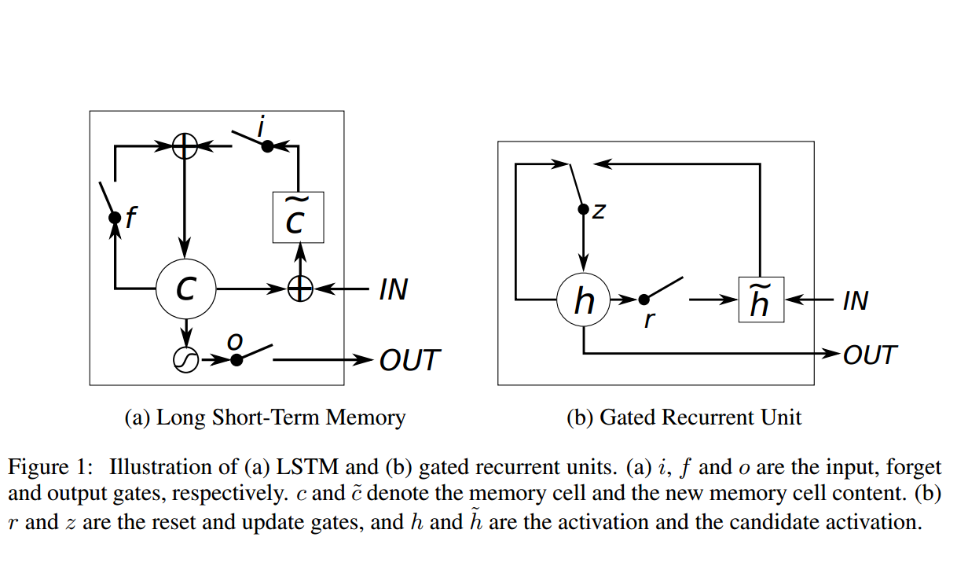
Recurrent Neural Network (RNN)
Name: Gated Recurrent Unit (GRU)
Description:
Simple RNN with reset and update gates as additional parameters when feeding past outputs as inputs
Notes:
r, z are the reset and update gates
h and h~ denote activation and candidate activation
<number>

Slide 28
Comparison of Models
Model | Accuracy Rank | Training Time Rank
Restricted Boltzmann Machine (RBM) | 4/4 | 4/4
Fully-Connected Network | 2/4 | 1/4
Convolution Neural Network (CNN) | 3/4 | 3/4
Recurrent Neural Network (RNN) | 1/4 | 2/4

Slide 29
Parameters | Types
Layer types | Dense, Convolution1D, Convolution1D+Maxpool1D, SimpleRNN, SimpleDeepRNN, LSTM, MUT-123
Activation Functions | Tanh, ReLU, sigmoid, hard-sigmoid
Dropout | 0.1 – 0.9
Hidden layers | 0+
Hidden layer nodes | 10+
Loss functions | MSE, MAE, RMSE, RMAE, RMSLE, RMALE
Optimization | SGD, Adagrad, Adadelta, RMSProp, Adam
Momentum | None, regular, Nesterov
Learning rates | 0.0001+
Learning rate decay | 1e-6+
Regularization | None, L1, L2
Filters | 5 - 50
Kernels | 2 - 24
Training Models
Parameters needed to be optimized
Notes:
<number>

Slide 30
Oil Well Predictions
Visualization of examples

Slide 31
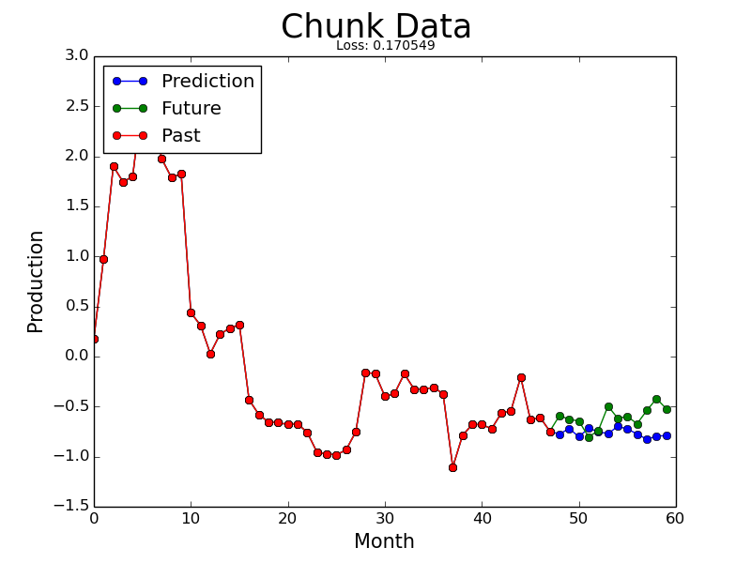

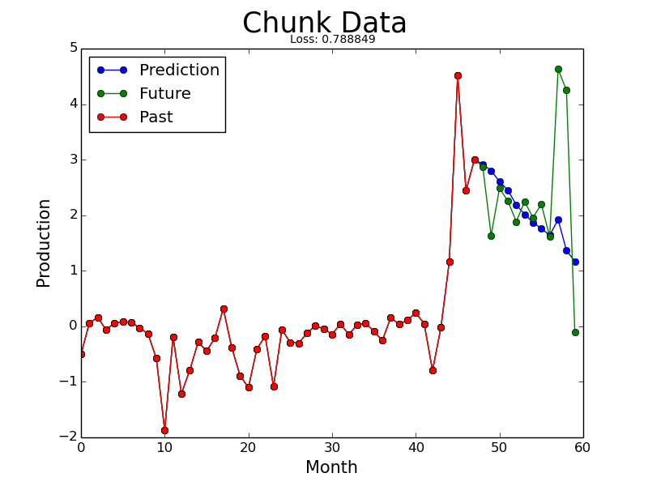
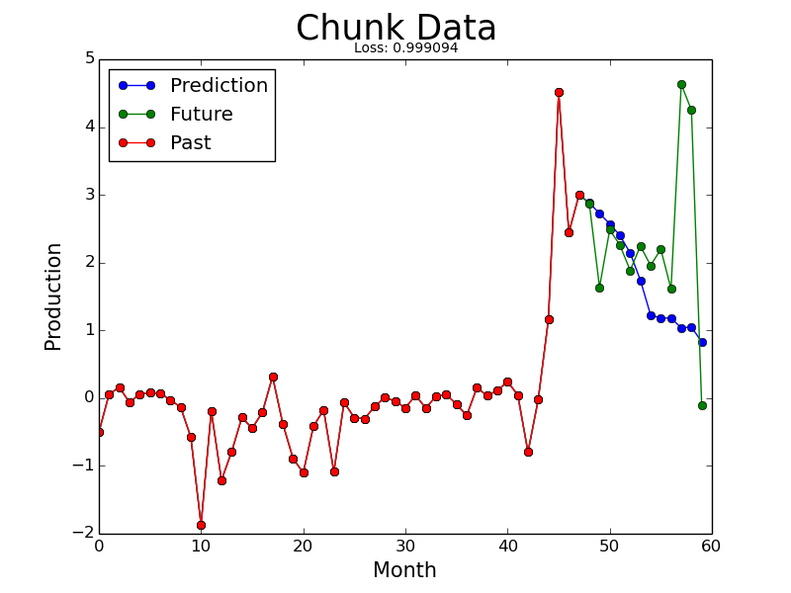
Oil Well Predictions
0-Layer Fully-Connected
GRU
Notes:
Predicts well
<number>

Slide 32
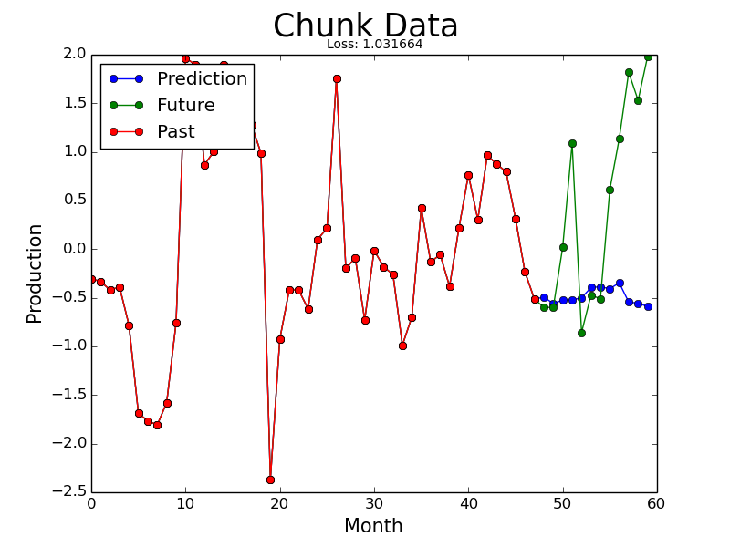

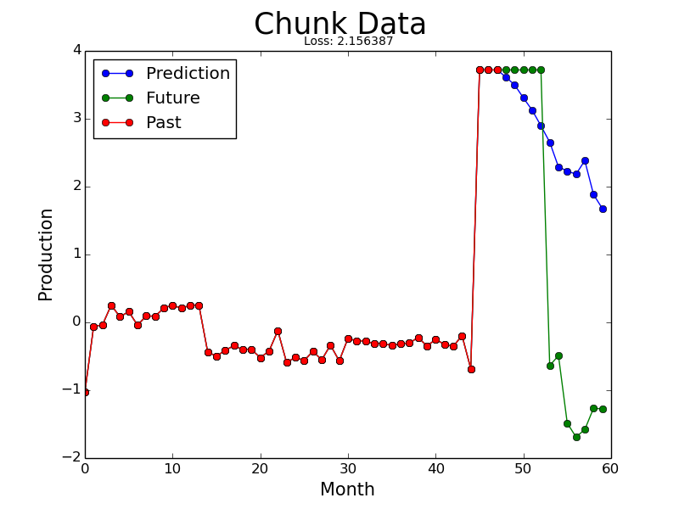
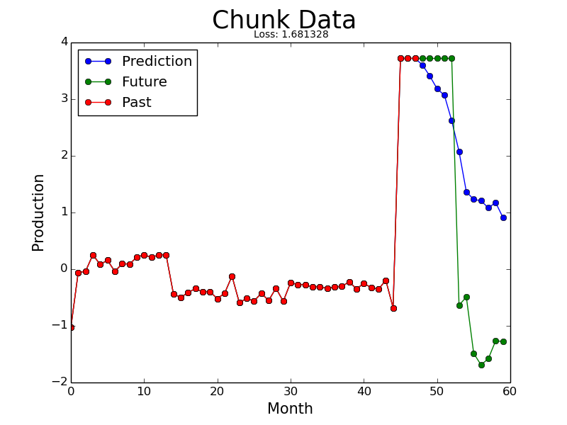
Oil Well Predictions
0-Layer Fully-Connected
GRU
Notes:
Predicts poorly, but mostly gets trend
<number>

Slide 33
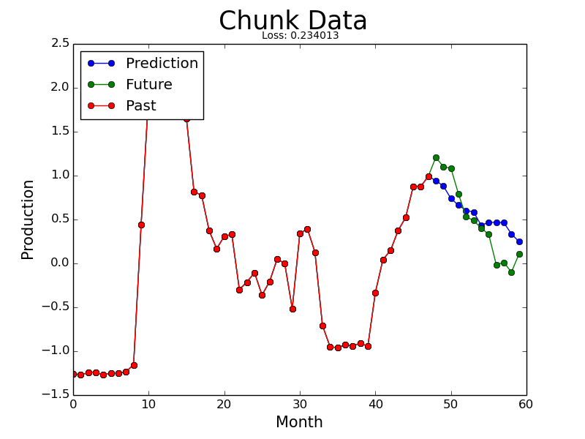

Oil Well Predictions
0-Layer Fully-Connected
GRU
Notes:
Both predict similarly
<number>

Slide 34
Conclusion
Promising:
Already offers reasonable predictions on limited data
Robust:
Applicable to other types of oil well data
Difficult:
Has room for optimization and improvement
Worthwhile:
Yielded profitable results
Notes:
• Does deep learning work on QRI data?
• How about with time series data and at-large?
• Summarize
<number>

Slide 35
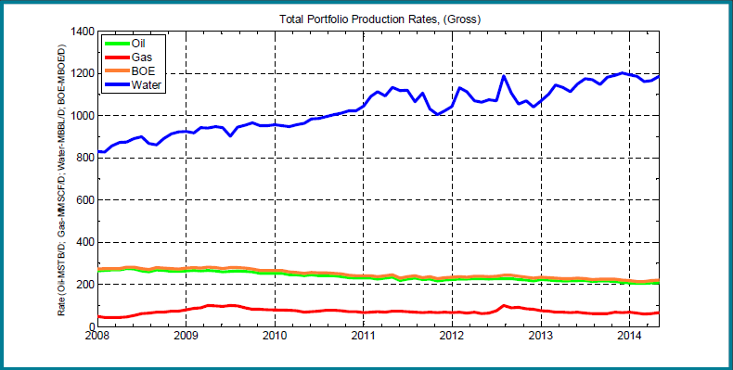
Future Directions
Further parameter optimization
Explore other neural network implementations:
Hierarchical Temporal Memory (HTM)
Incorporate water and gas data inputs to aid predictions
Train differently on different kinds of oil wells
Add events as an input to aid predictions
Notes:
Events: repairs, upgrades, other modifications to a well
<number>

Slide 36
Thank You
Questions?
We would like to extend our sincerest thanks to the directors of the Harvard John A. Paulson SEAS REU, the TRiCAM coordinators, QRI, and our wonderful mentor Verena Fittkau-Kaynig who enabled this project to happen.

